Slide 1
JD+ for advanced users
Decomposition models

Slide 2

Usual SA decomposition
Additive case:
$$y=s+t+i$$
$$y=sa+s$$
$$sa=t+i$$
Multiplicative case:
$$y=s∙t∙i$$
$$y=sa∙s$$
$$sa=t∙i$$

Slide 3
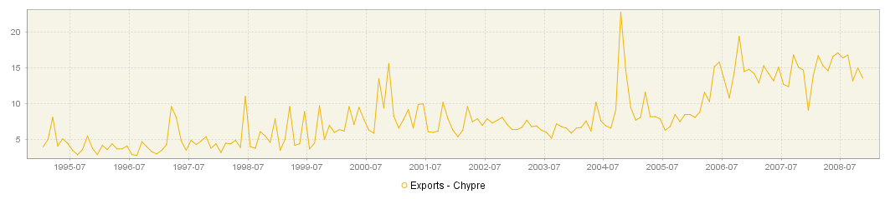
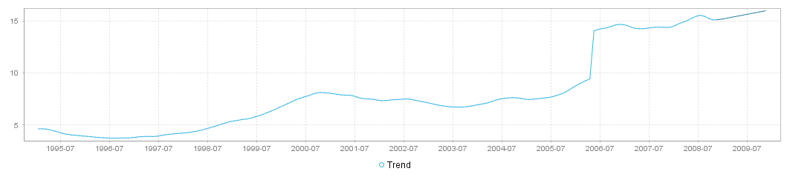
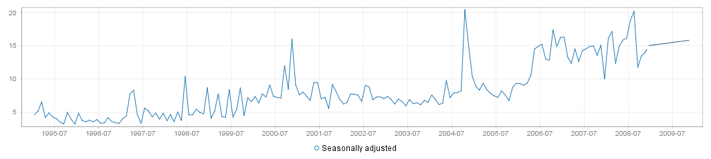
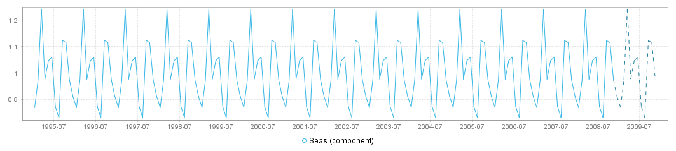
Volatile series
Stable trend and seasonal components
Volatile seasonally adjusted series

Slide 4
Two-steps methods
Identification of deterministic effects
Regression models (RegArima…)
Decomposition of the « linearized » series
Model-based decomposition
Pre-defined filters
Examples
Tramo-Seats, X12-Arima

Slide 5
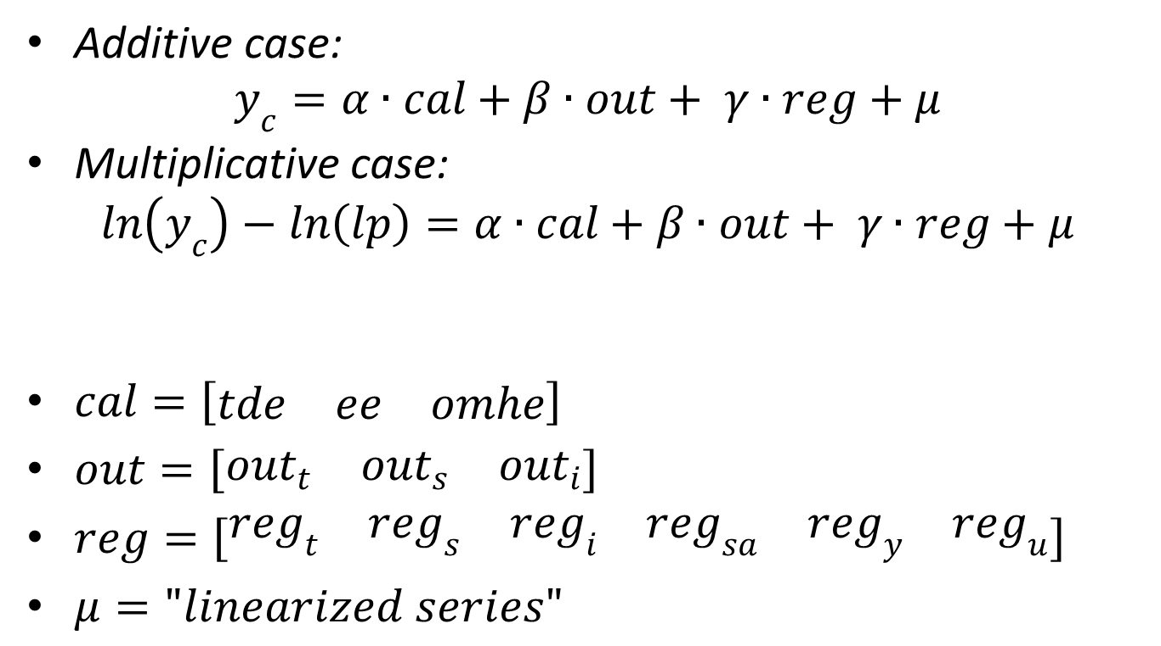
Regression model
Additive case:
$$y_{c}=α∙cal+β∙out+ γ∙reg+μ$$
Multiplicative case:
$$\ln\left(y_{c}\right)−ln\left(lp\right)=α∙cal+β∙out+ γ∙reg+μ$$
$cal=\left[\begin{matrix}tde & ee & omhe\end{matrix}\right]$
$out=\left[\begin{matrix}out_{t} & out_{s} & out_{i}\end{matrix}\right]$
$reg=\left[\begin{matrix}reg_{t} & reg_{s} & reg_{i} & reg_{sa} & reg_{y} & reg_{u}\end{matrix}\right]$
$μ="linearized series"$

Slide 6
Handling of the regression variables
Code | Description | Y_lin | T | S | I | SA
tde | Trading days (default, holidays, user-defined) | x |  | x
ee | Easter | x |  | x
omhe | Other moving holidays (TODO: Ramadan…) | x |  | x
AO | Additive outlier | x |  |  | x | x
TC | Transitory change | x |  |  | x | x
LS | Level shift | x | x |  |  | x
SO, SLS | Seasonal outlier / seasonal level shift | x |  | x
Reg_i | Regression variables allocated to irregular, IV (p) | x |  |  | x | x
Reg_t | Regression variables allocated to trend, ramps, IV (p) | x | x |  |  | x
Reg_s | Regression variables allocated to seasonal, IV (p) | x
Reg_sa | Regression variables allocated to seas. adjusted | x |  |  |  | x
Reg_y | Regression variables removed before decomp.
Reg_u | Regression variables unallocated to a component | x | p | p | p | p
IV (p) stands for intervention variables (partially)

Slide 7
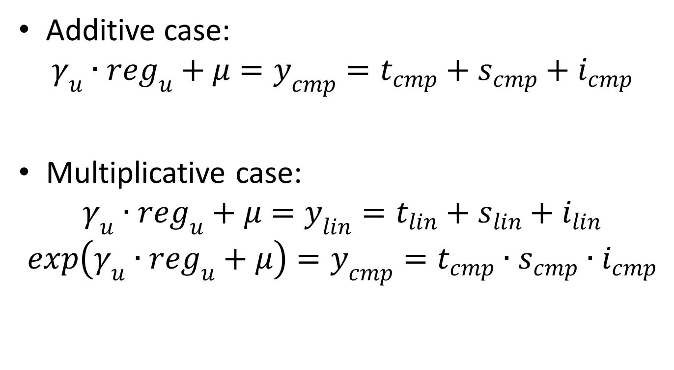
Decomposition
Additive case:
$$γ_{u}∙reg_{u}+μ=y_{cmp}=t_{cmp}+s_{cmp}+i_{cmp}$$
Multiplicative case:
$$γ_{u}∙reg_{u}+μ=y_{lin}=t_{lin}+s_{lin}+i_{lin}$$
$$exp\left(γ_{u}∙reg_{u}+μ\right)=y_{cmp}=t_{cmp}∙s_{cmp}∙i_{cmp}$$

Slide 8
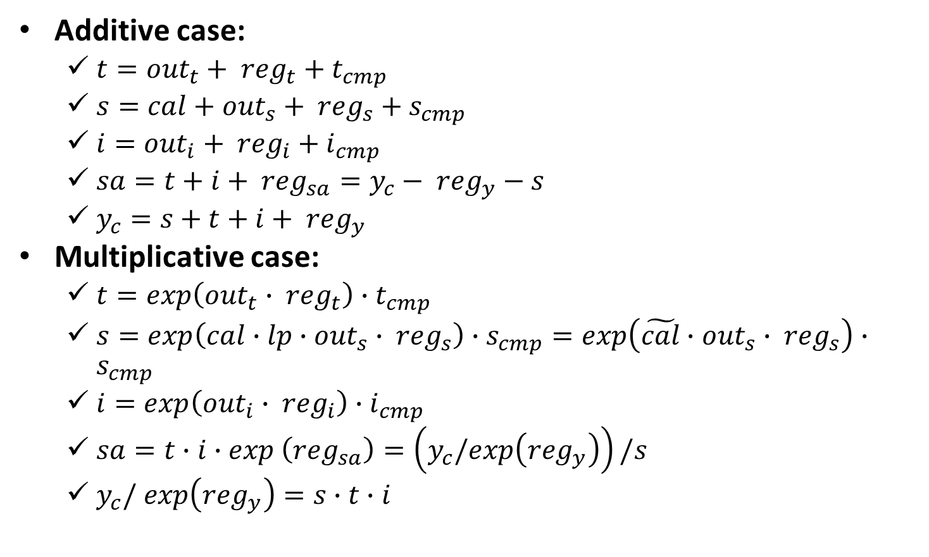
Final decomposition
Additive case:
$t={out}_{t}+ {reg}_{t}+t_{cmp}$
$s=cal+{out}_{s}+ {reg}_{s}+s_{cmp}$
$i={out}_{i}+ {reg}_{i}+i_{cmp}$
$sa=t+i+ {reg}_{sa}=y_{c}− {reg}_{y}−s$
$y_{c}=s+t+i+ {reg}_{y}$
Multiplicative case:
$t=exp\left({out}_{t}∙ {reg}_{t}\right)∙t_{cmp}$
$s=exp\left(cal∙lp∙{out}_{s}∙ {reg}_{s}\right)∙s_{cmp}=exp\left(\tilde{cal}∙{out}_{s}∙ {reg}_{s}\right)∙s_{cmp}$
$i=exp\left({out}_{i}∙ {reg}_{i}\right)∙i_{cmp}$
$sa=t∙i∙exp \left({reg}_{sa}\right)=\left(y_{c}/exp\left({reg}_{y}\right)\right)/s$
$y_{c}/ exp\left({reg}_{y}\right)=s∙t∙i$

Slide 9
SA_lin
LS
reg_trend, ramps
T_lin
T
SA
AO + TC
reg_i
I_lin
I
TD + Hol
SO [+ SLS]
reg_s
S_lin
S
Deterministic effects
Stochastic components

